Slide 1

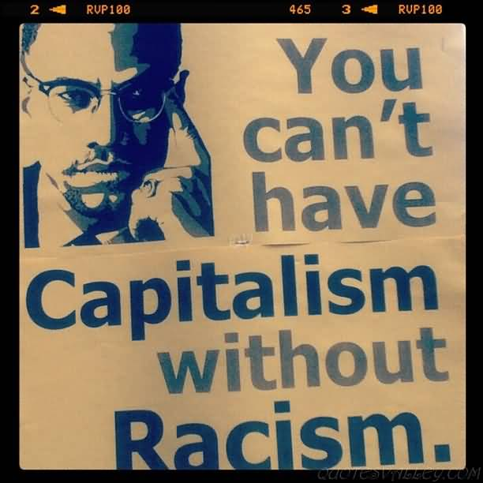

Racial Capitalism in Post-Apartheid South Africa
Ihsaan Bassier
PhD Student, Economics
UMass, Amherst

Slide 2
Race-based differences persist
Without explicitly discriminatory laws
Without strong collusion
Beyond capitalist relations
How?

Slide 3

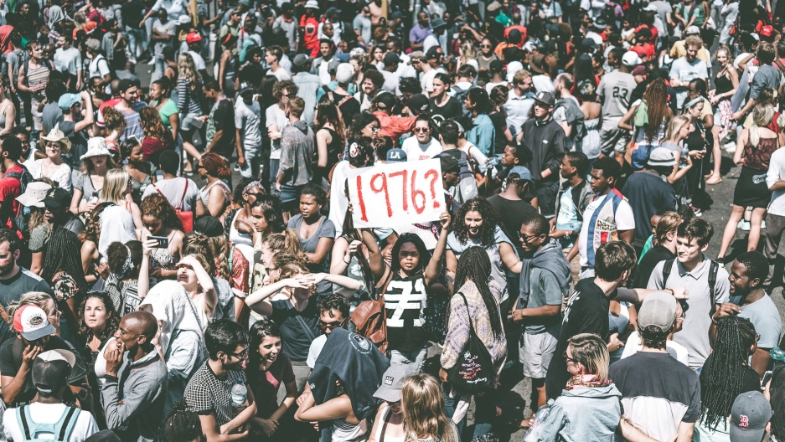
Context: South Africa

Slide 4
Theories of reproducing Difference
Literature | Relation | Application to Race
Capital | Propertied and workers | Inheritance
Imperialism | Metropole and periphery | Labour sorting
Racial Capitalism | White Property Owners and Black Workers | Structural Coercion
Apartheid | White Mine-Owners and Black Migrants | Reproductive Subsidy

Slide 5
Channel 1: Black wage labour
 | White | Black
Predicted ln(wage) | 9.00 | 7.67
% Difference | Explained | Unexplained
Occupation | 0.321*** | 0.867
Industry | 0.121*** | 0.460
Age | 0.0508* | -0.116
Education | 0.310*** | 1.150*
Total | 0.803*** | 0.532***

Slide 6
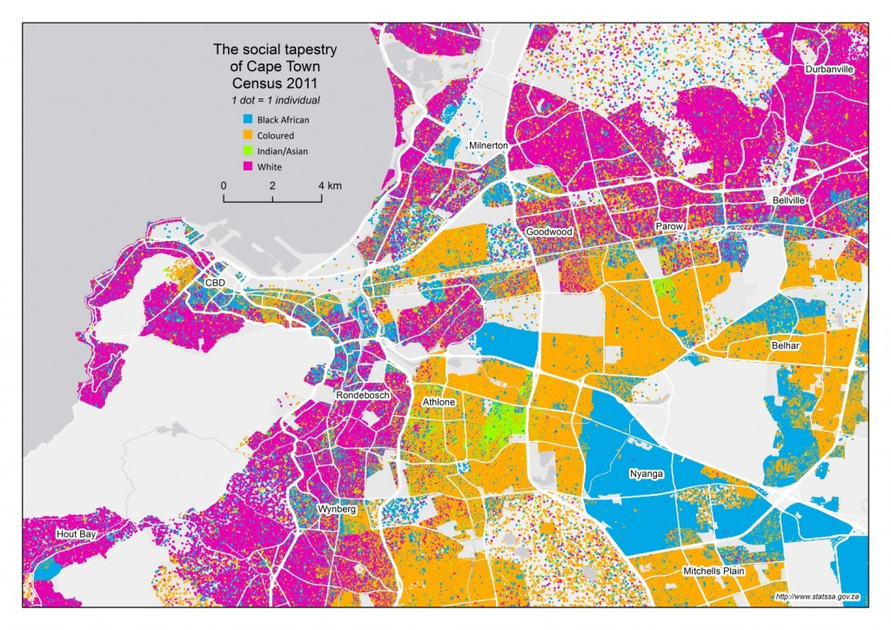
Channel 2: Space
Rural – Reproductive subsidy
Urban – Second economy

Slide 7
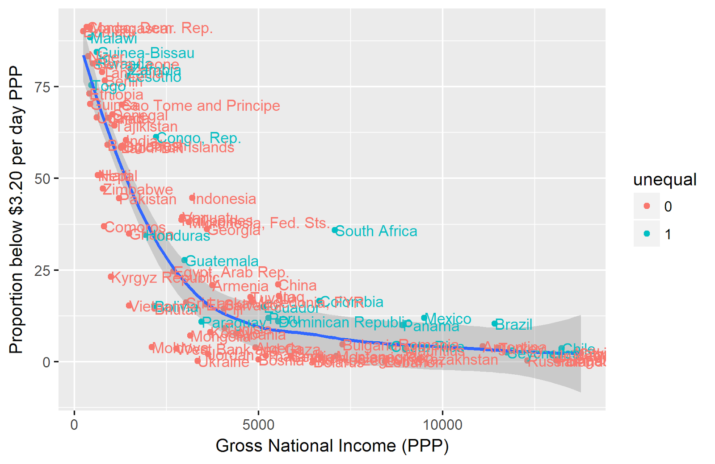
Channel 3: Structural coercion
Organisations in setting norms
Lobbying

Slide 8
Common Themes
What is the incentive for white capitalists and black workers?
Race-based processes: Group-based sorting Networks
Materially-based processes: Firm Survival Organizational power

Slide 9
“The close links between class and race developed in Africa alongside capitalist exploitation… the classic example is South Africa, where Africans experience a double exploitation - both on the ground of colour and of class. Similar conditions exist in the USA, the Caribbean, in Latin America…” – Nkrumah, 1971

